Slide 1

TENSOR NETWORKS
SAAD QASIM ABBASI
Supervised by: Dr. Muhammad Irfan

Slide 2
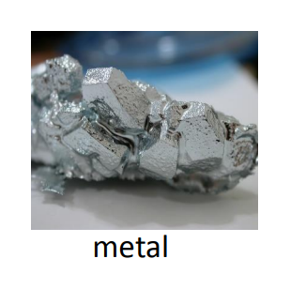

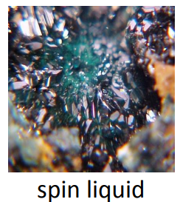
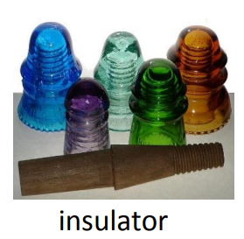
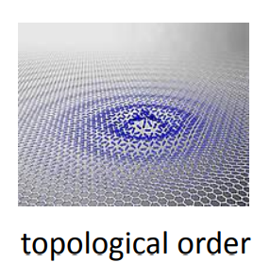
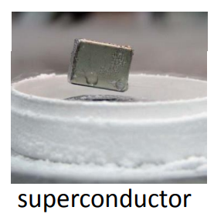
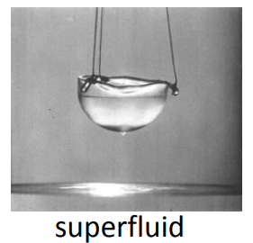
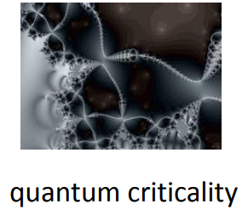
Emergent phenomenon in many-body systems

Slide 3
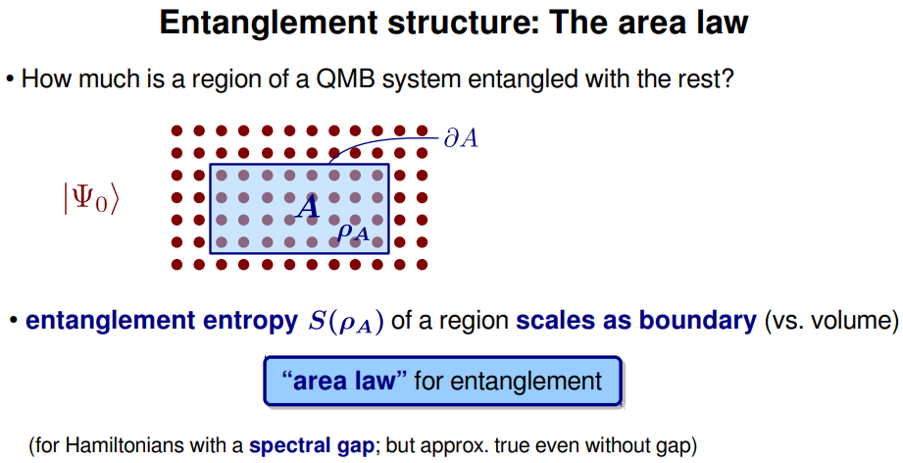
Area law for entanglement growth

Slide 4
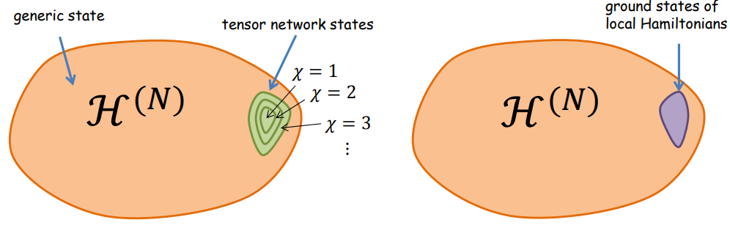
Area law for entanglement growth
The manifold of quantum states in the Hilbert space that obeys the area law scaling for the entanglement entropy corresponds to a tiny corner in the overall huge space.

Slide 5
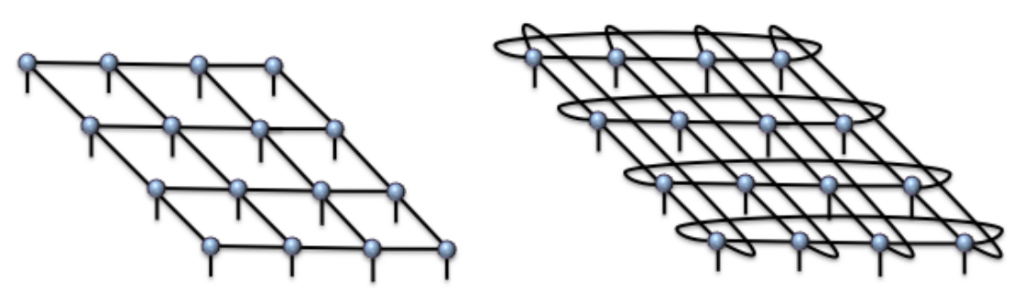
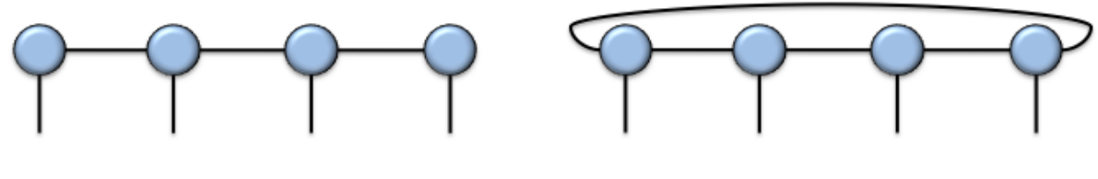
LOW ENTANGLEMENT STATES → TENSOR NETWORK
Different Tensor Networks reflect different geometries of entanglement.
MPS with open boundary conditions
MPS with periodic boundary conditions
PEPS with open
boundary conditions
PEPS with periodic
boundary conditions.

Slide 6
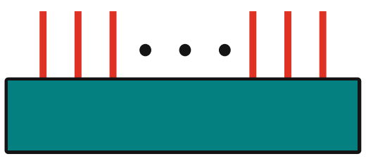







GRAPHICAL LANGUAGE OF TENSOR NETWORK

Slide 7
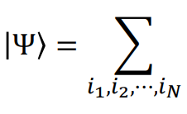

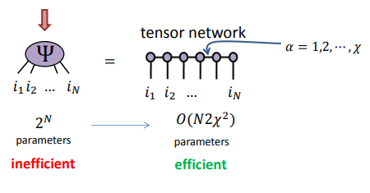
Many body wavefunction of n-particles

Slide 8
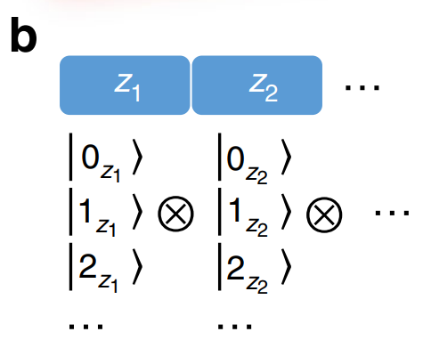

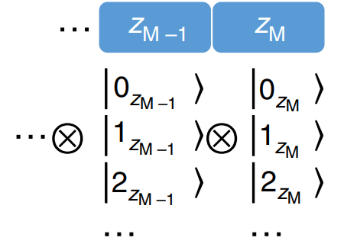
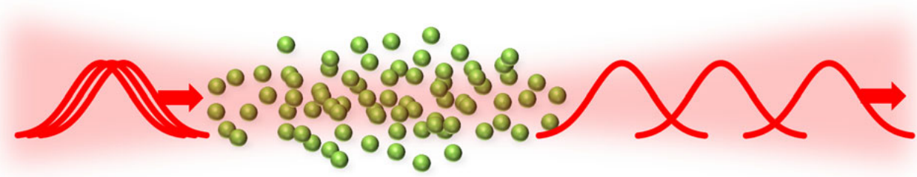
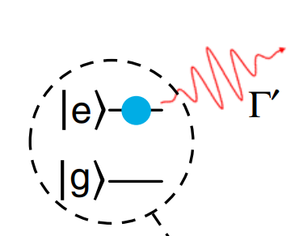

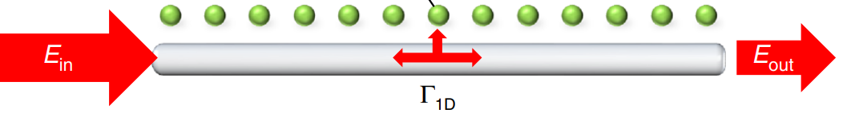
Simulating quantum light propagation through atomic ensembles using matrix product states

Slide 9
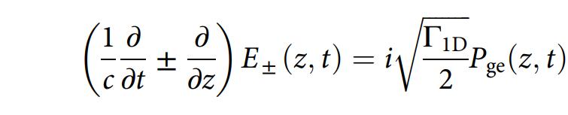
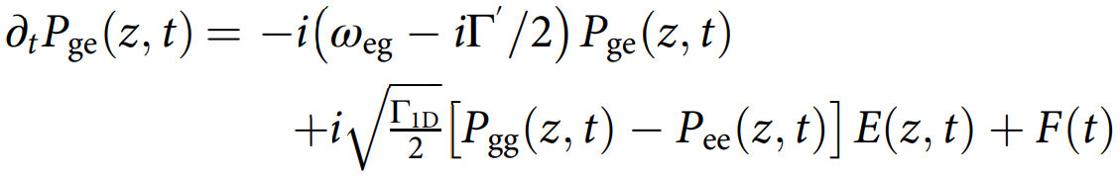
Widely accepted as the standard model for quasi-1D light propagation through atomic ensembles.
1
Pge (z) : Atomic polarization density operator
Γ_{1D} : Coupling rate of an individual atom to one dimensional mode
ω_{eg}: Atomic transition frequency,
P_{ee,gg} : Excited and Ground state populations
F: Quantum noise associated with decay rate Γ′
2

Slide 10
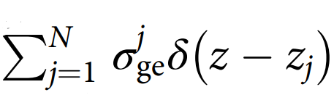
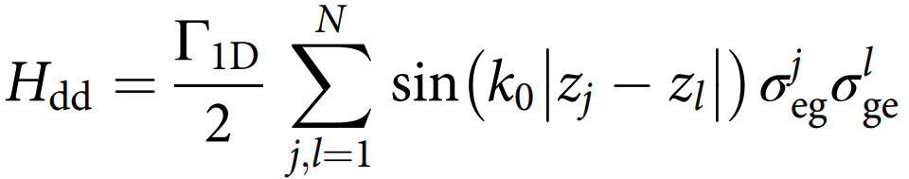

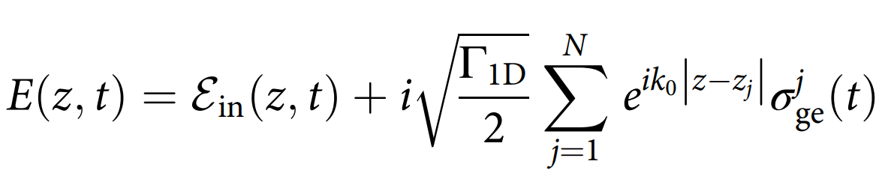
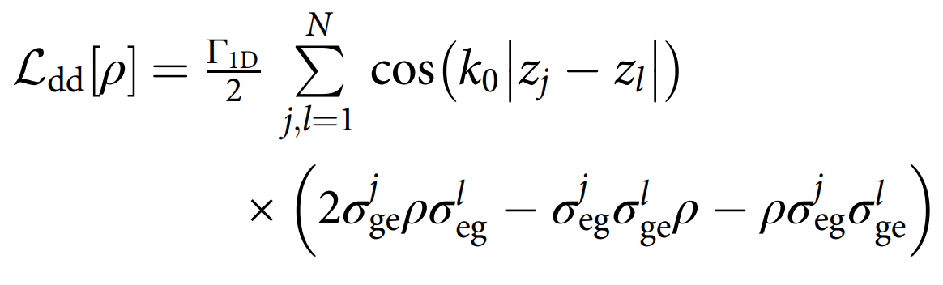
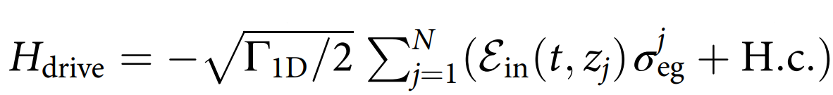
1D spin model of light propagation
3
5
4
6
7

Slide 11
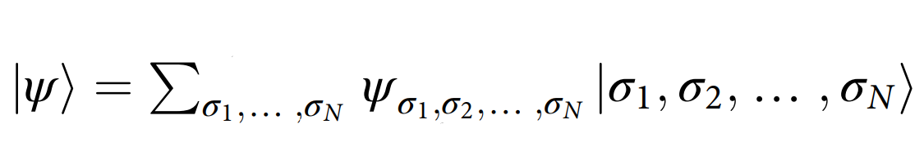

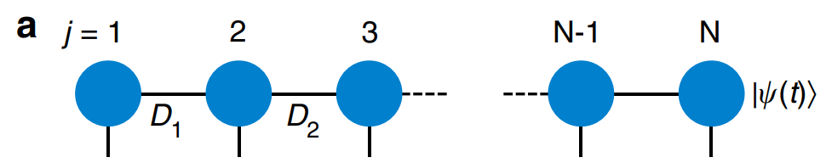
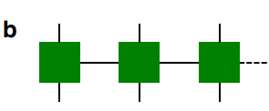
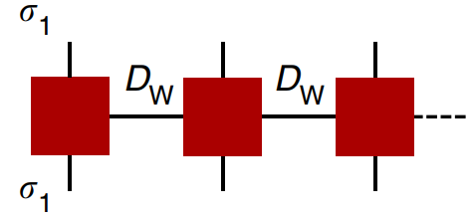


Simulations using matrix product states

Slide 12
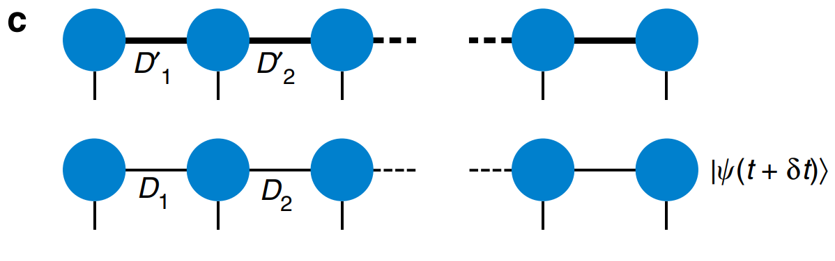
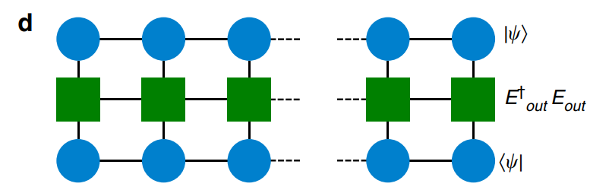
Simulations using matrix product states

Slide 13
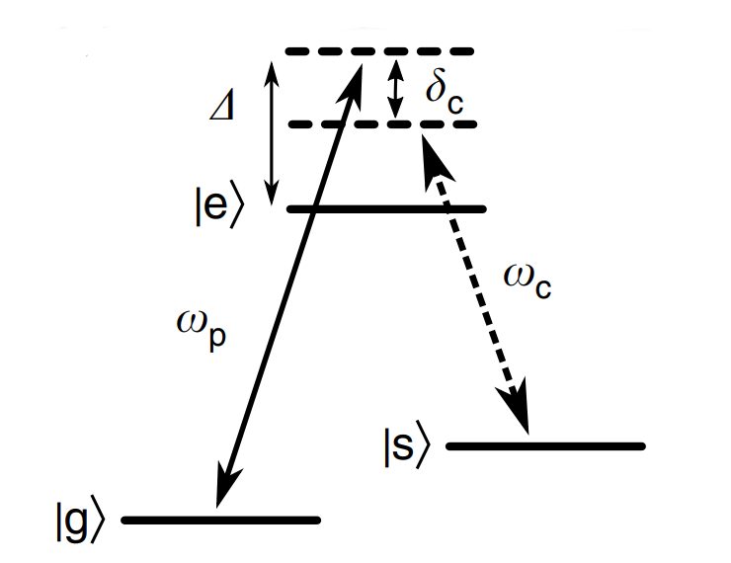
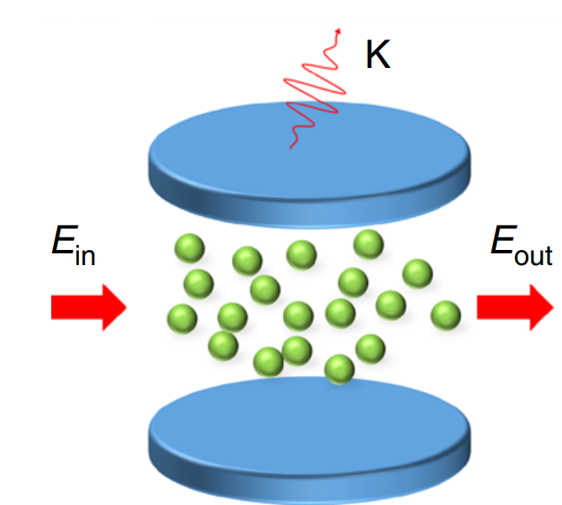
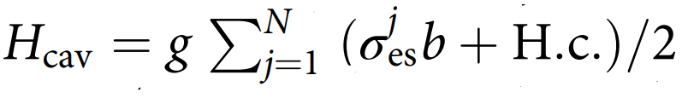
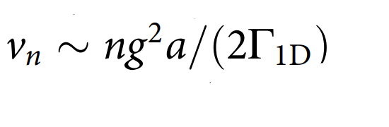
Vacuum induced transparency
8

Slide 14
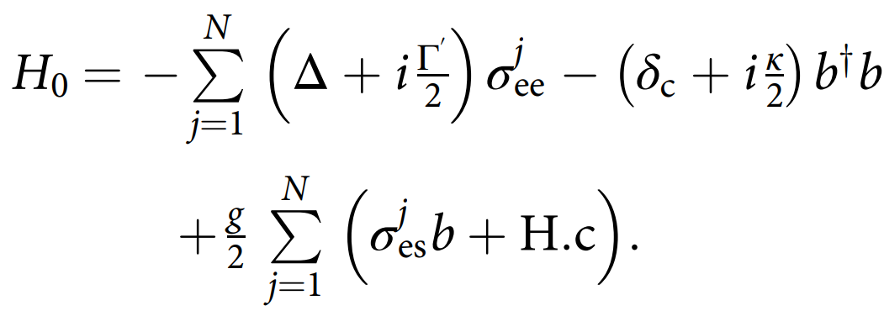


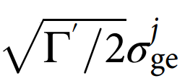



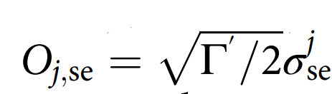
Vacuum induced transparency
Atomic part H₀ of the total effective Hamiltonian
Jump operator corresponding to cavity decay
10
Free-space spontaneous emission into state
11
9
Free-space spontaneous emission into state
12

Slide 15


Quantum jump formalism
Master equation for our 1D spin model
13
O_{l} are the jump operators
14
15
16

Slide 16

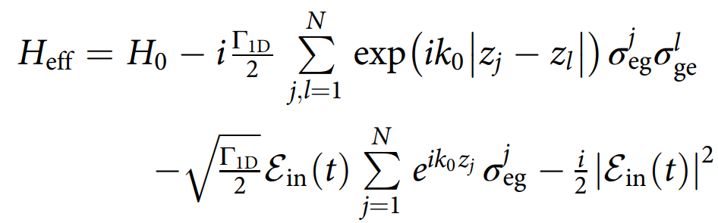


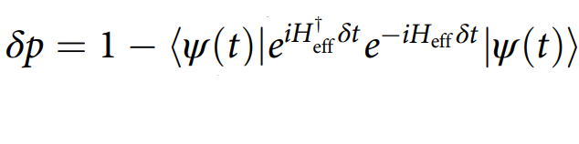
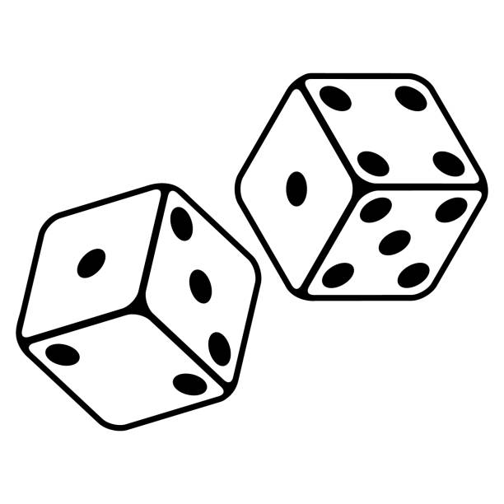

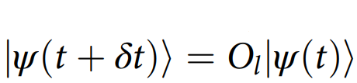
Quantum jump formalism
17
(a) Deterministic evolution under H_{eff}
(b) Stochastic quantum jumps made by applying jump operators O_{l}
r
> δp
< δp

Slide 17
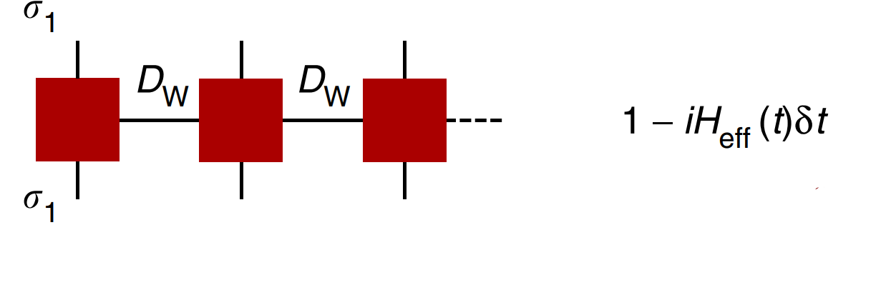
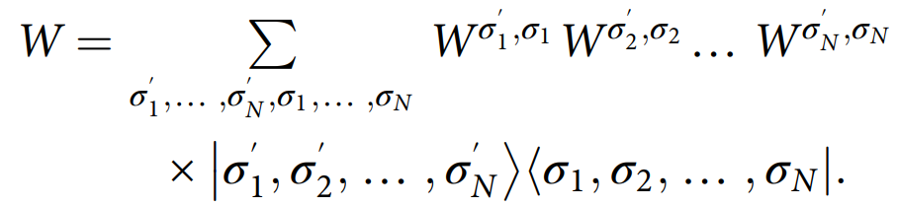
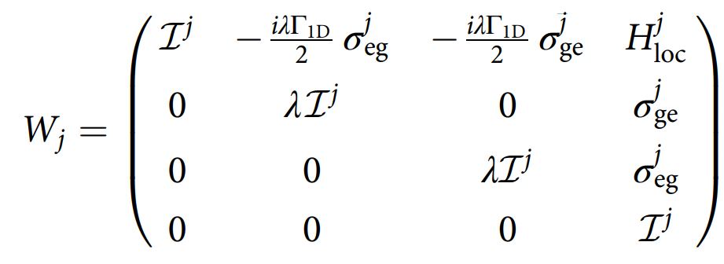


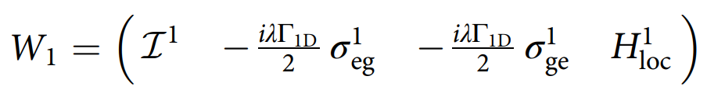
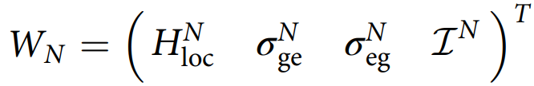
(a) Deterministic Time evolution
Operator W can be expressed in a local representation as:

Slide 18
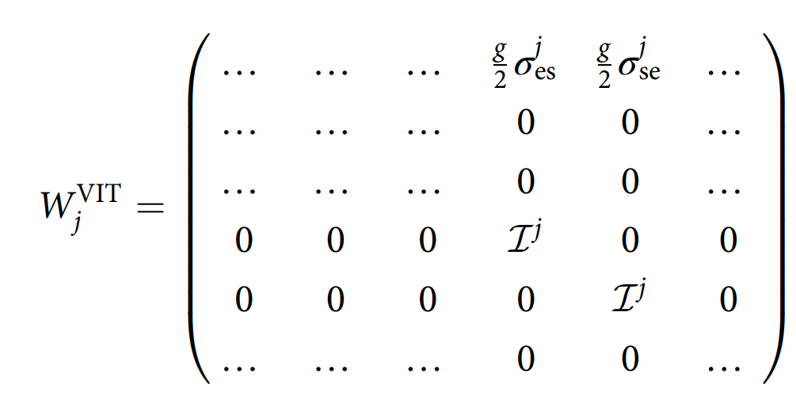
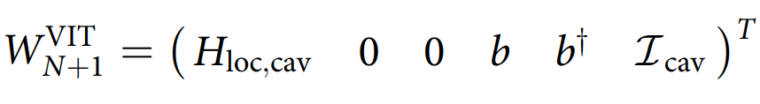
Contd.

Slide 19









(b) Quantum jumps

Slide 20





Results

Slide 21
Results

Slide 22
Results

Slide 23
Results

Slide 24

VIT PULSE DISTORTION

Slide 25




Results
|α|² = 0.01
|α|² = 0.25
|α|² = 2.0
|α|² = 1.0

Slide 26
Results

Slide 27
Results

Slide 28
References
[1] Browaeys and T. Lahaye, "Many-body physics with individually controlled Rydberg atoms," Nat. Phys., vol. 16, pp. 132-142, 2020.
[2] H. Tanji-Suzuki, W. Chen, R. Landig, J. Simon, and V. Vuletić, ‘Vacuum-induced transparency’, Science, vol. 333, no. 6047, pp. 1266–1269, 2011.
[3] M. T. Manzoni, D. E. Chang, and J. S. Douglas, ‘Simulating quantum light propagation through atomic ensembles using matrix product states’, Nature communications, vol. 8, no. 1, p. 1743, 2017.
[4] X.-B. Wang, T. Hiroshima, A. Tomita, and M. Hayashi, ‘Quantum information with Gaussian states’, Physics reports, vol. 448, no. 1–4, pp. 1–111, 2007.
[5] D. E. Browne, J. Eisert, S. Scheel, and M. B. Plenio, ‘Driving non-Gaussian to Gaussian states with linear optics’, Physical Review A, vol. 67, no. 6, p. 062320, 2003.
[6] K. M. Birnbaum, A. Boca, R. Miller, A. D. Boozer, T. E. Northup, and H. J. Kimble, ‘Photon blockade in an optical cavity with one trapped atom’, Nature, vol. 436, no. 7047, pp. 87–90, 2005.

Slide 29

Thank You

